Slide 1
ScienceQtech Employee Performance Mapping
Presented by: N Surendra Reddy

Slide 2




Content

Slide 3
COMPANY OVERVIEW
ScienceQtech is a startup that works in the Data Science field.
ScienceQtech has worked on fraud detection, market basket, self-driving cars, supply chain, algorithmic early detection of lung cancer, customer sentiment, and the drug discovery field
The annual appraisal cycle around the corner, the HR department has asked you to generate reports on employee details, their performance, and on the project that the employees have undertaken, to analyze the employee database and extract specific data based on different requirements.

Slide 4
PROBLEM STATEMENT
find the maximum salary of the employees and ensure that all jobs are meeting the organization's profile standard.
You also need to calculate bonuses to find extra cost for expenses.
This will raise the overall performance of the organization by ensuring that all required employees receive training.

Slide 5
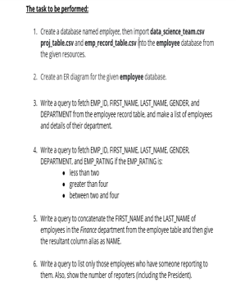
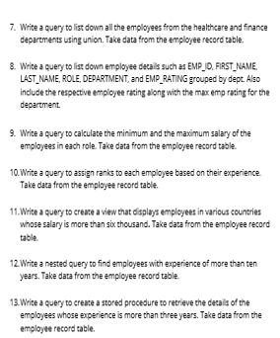
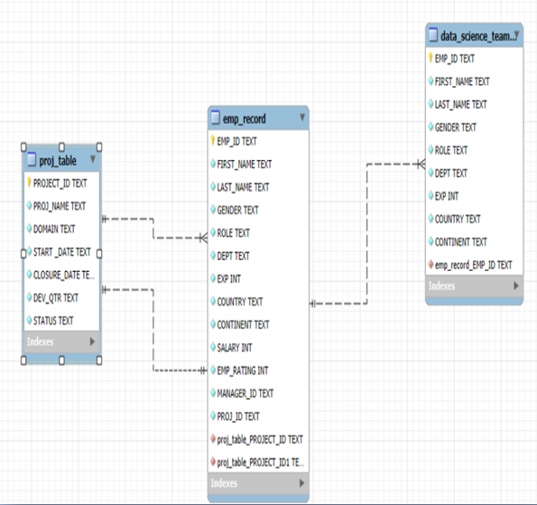
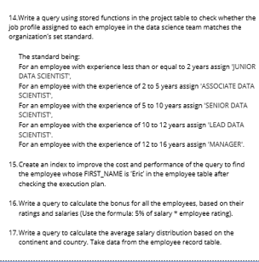
Dataset

Slide 6
LET’S SEE SCIENCEQTECH EMPLOYEE PERFORMANCE, QUERY, RESULTS AND INSIGHTS

Slide 7
QUESTION 3 Write a query to fetch EMP_ID, FIRST_NAME, LAST_NAME, GENDER, and DEPARTMENT from the employee record table, and make a list of employees and details of their department. CODE: select emp_id, first_name, last_name, gender, dept from emp_record;

Slide 8
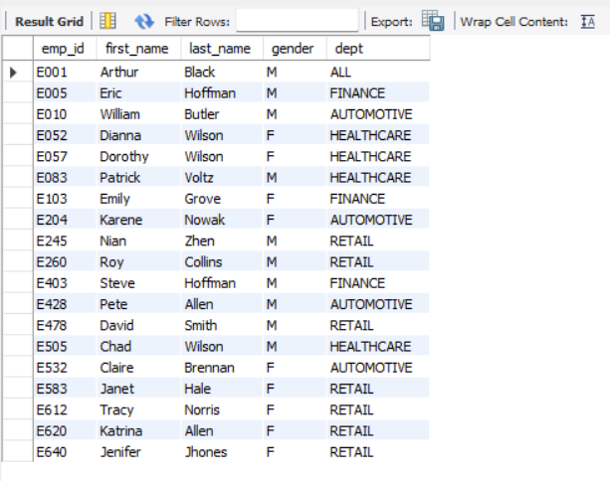
OUTPUT:

Slide 9
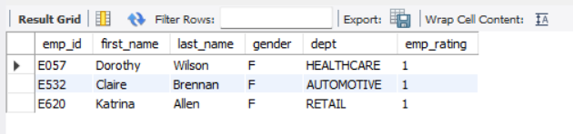
QUESTION 4 Write a query to fetch EMP_ID, FIRST_NAME, LAST_NAME, GENDER,DEPARTMENT, and EMP_RATING if the EMP_RATING is: ● less than two ● greater than four ● between two and four CODE: select emp_id, first_name, last_name, gender, dept, emp_rating from emp_record where emp_rating < 2; OUTPUT:

Slide 10
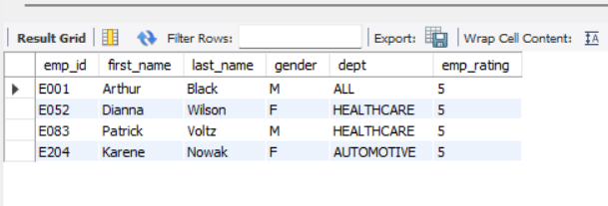
CODE: select emp_id, first_name, last_name, gender, dept, emp_rating from emp_record where emp_rating > 4; OUTPUT:

Slide 11
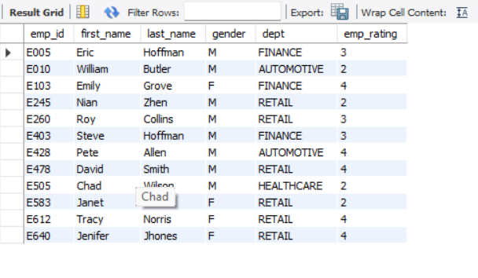
CODE: select emp_id, first_name, last_name, gender, dept, emp_rating from emp_recordwhere emp_rating between 2 and 4; OUTPUT:

Slide 12
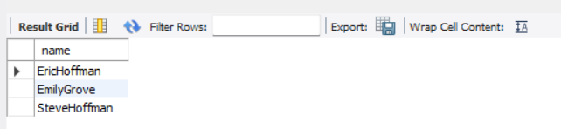
Question 5: Write a query to concatenate the FIRST_NAME and the LAST_NAME of employees in the Finance department from the employee table and then give the resultant column alias as NAME. CODE: select concat(first_name, last_name) as name from emp_record where dept = 'finance’; OUTPUT:

Slide 13
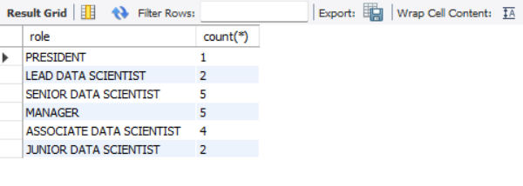
QUESTION 6: Write a query to list only those employees who have someone reporting tothem. Also, show the number of reporters (including the President) . CODE: select role, count(*) from emp_record group by role; OUTPUT:

Slide 14
QUESTION 7: Write a query to list down all the employees from the healthcare and financedepartments using union. Take data from the employee record table. CODE: select first_name, last_name, dept from emp_record where dept='healthcare’ union select first_name, last_name, dept from emp_record where dept='finance’;

Slide 15
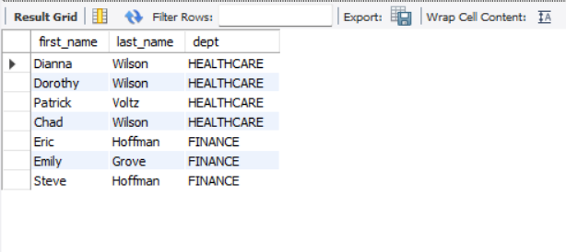
OUTPUT:

Slide 16
QUESTION 8: Write a query to list down employee details such as EMP_ID, FIRST_NAME,LAST_NAME, ROLE, DEPARTMENT, and EMP_RATING grouped by dept. Also include the respective employee rating along with the max emp rating for the department. CODE: select emp_id, first_name, last_name, role, dept, emp_rating,emp_rating as max_rating from emp_record where(dept, emp_rating) IN (select dept, max(emp_rating) from emp_record group by dept);

Slide 17
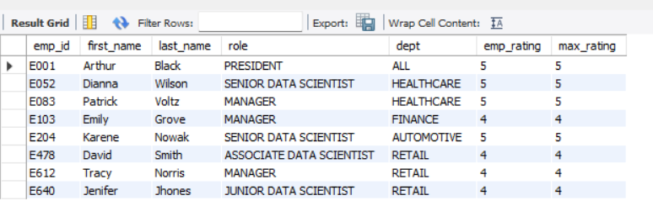
OUTPUT:

Slide 18
QUESTION 9: Write a query to calculate the minimum and the maximum salary of the employees in each role. Take data from the employee record table. CODE: select role, min(salary) as minsalary, max(salary) as maxsalary from emp_record group by role;

Slide 19
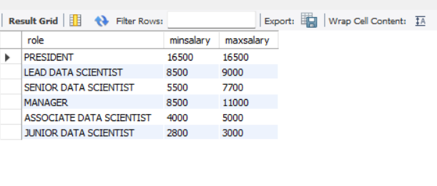
OUTPUT:

Slide 20
QUESTION 10: Write a query to assign ranks to each employee based on their experience. CODE: select emp_id, first_name, last_name, exp, dense_rank() over(order by exp desc) from emp_record;

Slide 21
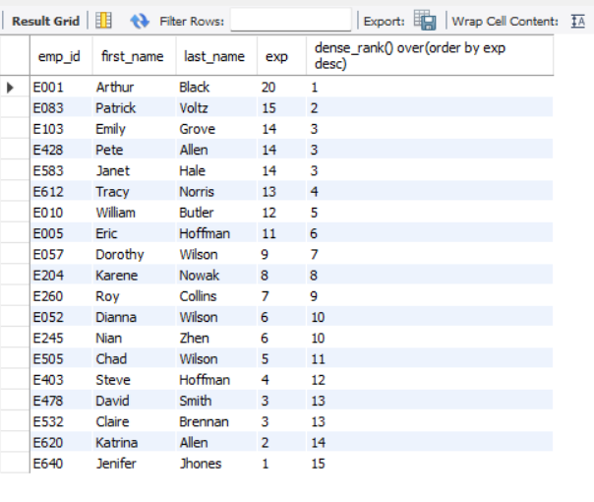
OUTPUT:

Slide 22
QUESTION 11: Write a query to create a view that displays employees in various countrieswhose salary is more than six thousand. Take data from the employee record table. CODE: create view six_thousand_salary as select emp_id, first_name, last_name, country, salary from emp_record where salary > 6000; select * from six_thousand_salary;

Slide 23
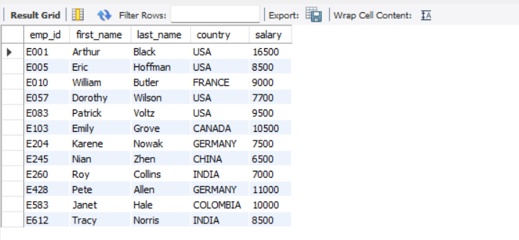
OUTPUT:

Slide 24
QUESTION 12: Write a nested query to find employees with experience of more than ten years. Take data from the employee record table. CODE: select emp_id, first_name, last_name, exp from emp_record where exp in(select exp from emp_record where exp > 10);

Slide 25
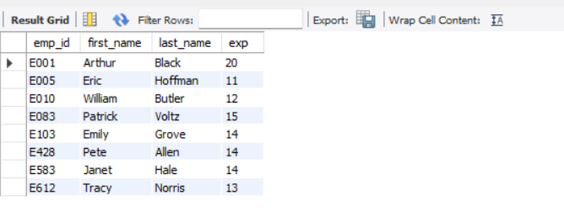
OUTPUT:

Slide 26
QUESTION 13: Write a query to create a stored procedure to retrieve the details of the employees whose experience is more than three years. Take data from the employee record table. CODE: DELIMITER $$ USE `employee`$$ CREATE PROCEDURE `Employee` () BEGIN select * from emp_record where exp > 3; END$$ DELIMITER ; call employee;

Slide 27
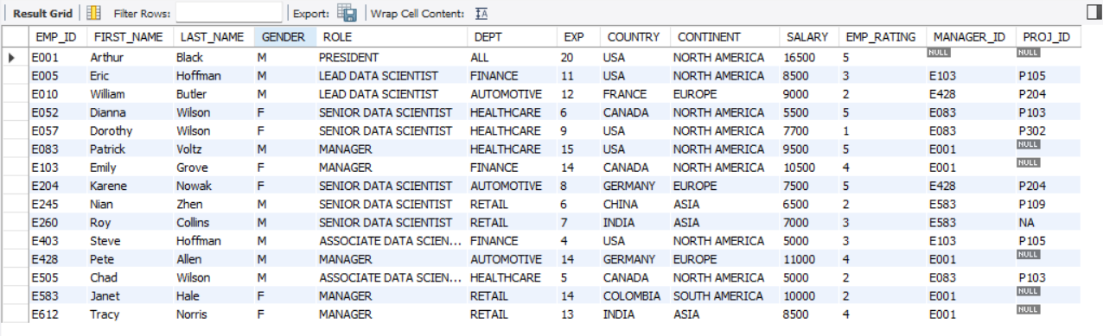
OUTPUT:

Slide 28
QUESTION 14: Write a query using stored functions in the project table to check whether the job profile assigned to each employee in the data science team matches the organization’s set standard. The standard being: For an employee with experience less than or equal to 2 years assign 'JUNIOR DATA SCIENTIST’, For an employee with the experience of 2 to 5 years assign 'ASSOCIATE DATA SCIENTIST’, For an employee with the experience of 5 to 10 years assign 'SENIOR DATA SCIENTIST’, For an employee with the experience of 10 to 12 years assign 'LEAD DATA SCIENTIST’, For an employee with the experience of 12 to 16 years assign 'MANAGER'.

Slide 29
CODE: DELIMITER $$ USE `employee`$$ CREATE PROCEDURE `Assign_role` () BEGIN select emp_id, first_name, last_name,gender, role, dept, exp, country, continent, salary, emp_rating, manager_id, proj_id, case when exp <=2 then 'JUNIOR DATA SCIENTIST' when exp between 2 and 5 then 'ASSOCIATE DATA SCIENTIST' when exp between 5 and 10 then 'SENIOR DATA SCIENTIST' when exp between 10 and 12 then 'LEAD DATA SCIENTIST' when exp between 12 and 16 then 'manager’ END as Assigned_role from emp_record; END$$ DELIMITER ; call assign_role;

Slide 30
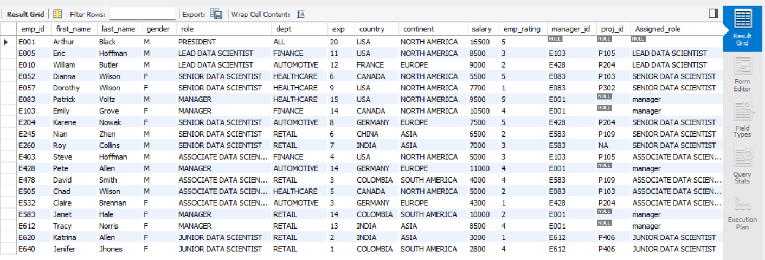
OUTPUT:

Slide 31
QUESTION 15: Create an index to improve the cost and performance of the query to find the employee whose FIRST_NAME is ‘Eric’ in the employee table after checking the execution plan. CODE: create index employee1 on emp_record (first_name(20)); select * from emp_record where first_name='Eric';

Slide 32
OUTPUT:

Slide 33
QUESTION 16: Write a query to calculate the bonus for all the employees, based on their ratings and salaries (Use the formula: 5% of salary * employee rating). CODE: select first_name, last_name, salary, ((salary * .05)*emp_rating) as bonus from emp_record;

Slide 34
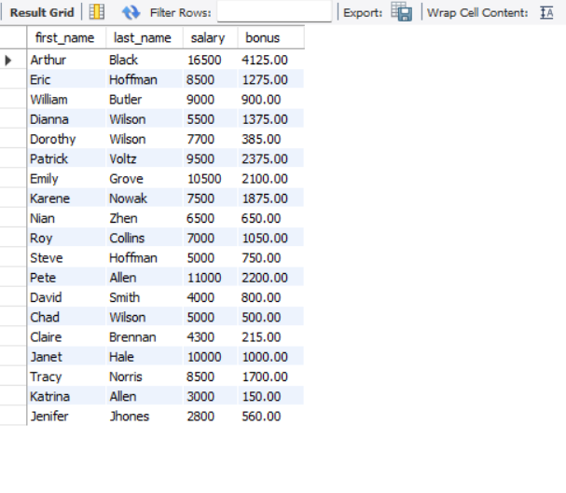
OUTPUT:

Slide 35
QUESTION 17: Write a query to calculate the average salary distribution based on the continent and country. Take data from the employee record table. CODE: select continent, avg(salary) as avgsalary from emp_record group by continent; select country, avg(salary) as avgsalary from emp_record group by country;

Slide 36
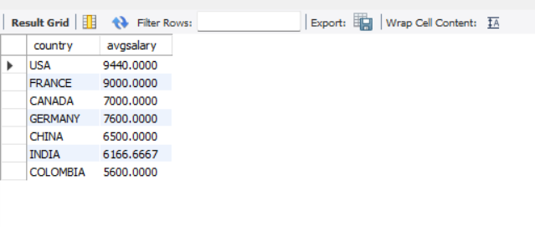
OUTPUT:

